Slide 1
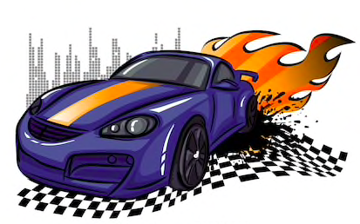
GEARS
Speeeeeeed it up….........

Slide 2
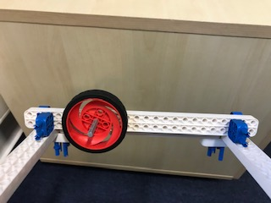
The wheel moves on its own.

Slide 3
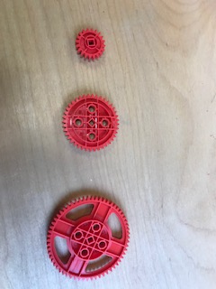
Three gear sizes
60 teeth
40 teeth
20 teeth

Slide 4
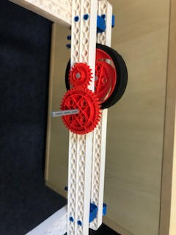
The wheel moves along with the small gear. The 40-teeth-gear doubles the speed of the 20-teeth-gear.
2 x v

Slide 5
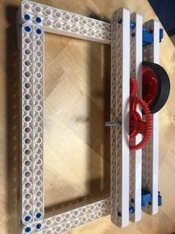
Now Let’s drive even faster!!!!
3 x v

Slide 6

Hey, Sloooow down there!

Slide 7
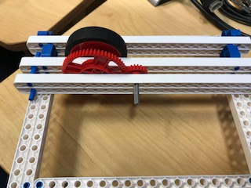
Now Let’s slow down with changing the gears’ order.
0.33 x v
The 20-teeth-gear slows down the 60-teeth-gear to the third of its speed

Slide 8
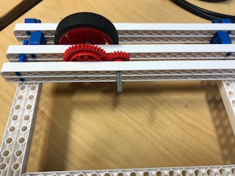
Guess what does the 20-teeth-gear do to the 40-teeth-one? ….yes, it slows it down to half of its speed.
0.5 x v

Slide 9


